Slide 1
CSE221
Structure and Interpretation of
Computer Programs
Procedures as
Black Box Abstractions

Slide 2
Square Root
Definition:
√ x = y ;
such that y >= 0 and (y * y) = x
OR
define (sqrt x)
(the y (and (>= y 0) (= (square y) x))))
- This can help to check if ‘y’ is a square root of ‘x’.
- But cannot help us find the value of ‘y’.
- Hence, a procedure must be defined to find square root of ‘x’ i.e. the value of ‘y’.

Slide 3
Example: Square
Root by Newton's
Method

Slide 4
Square Root Algorithm
Approach: Newton’s method successively approximates the guess of ‘y’ by averaging the y and x/y.
-The approximation is repeated until y² gets very close to x
- i.e. | (x – y²) | <= user-defined-error.
Algorithm:
  Make a guess, say ‘Guess’
  Improve the Guess by averaging Guess and X/Guess.
  Keep improving the Guess until it is good enough.

Slide 5
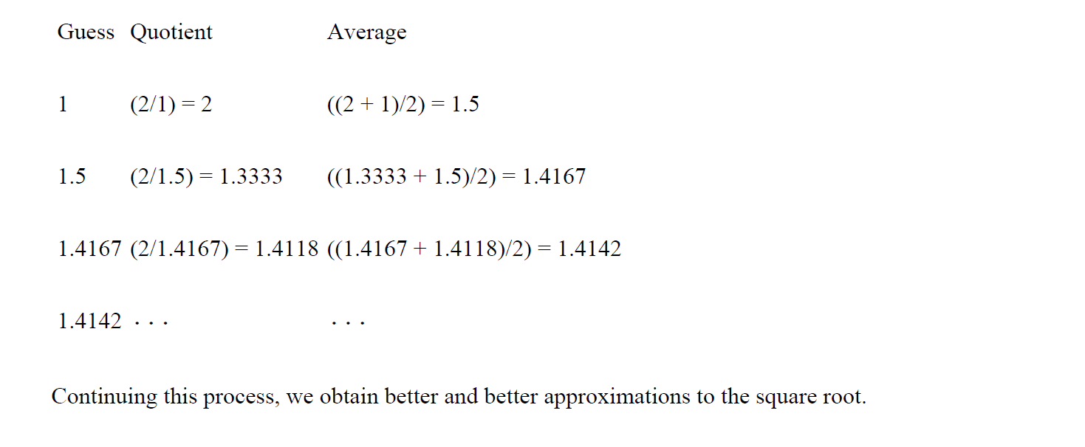
Example - (square root of 2)
x/Guess
Improve Guess
i.e. Say a ‘Guess’ is good enough when | (x – Guess²) | <= 0.0001

Slide 6
Procedure steps
Step 1: Make an initial Guess for square root of ‘x’ ; say IniGuess = 1.
(define IniGuess 1)
Step 2: Check if Guess is good-enough; Define procedure
(define (good-enough? guess x)
(< (abs (- (square guess) x)) 0.0001)
)
Step 3: Improve the values of Guess; Define procedure
(define (improve guess x)
(average guess (/ x guess))
)

Slide 7
Helper Procedures
Where,
(define (square x)
(* x x)
)
(define (average x y)
(/ (+ x y) 2 )
)

Slide 8
Square Root Procedure
Step 4: Now combine these procedures in the defined algorithmic manner to successively approximate the values of ‘Guess’
guess=1 x=2
(define (sqrt-iter guess x)
(if (good-enough? guess x)
guess
(sqrt-iter (improve guess x) x)
)
)

Slide 9
Square Root Procedure
Step 5: Lastly define the main sqrt() procedure for ‘x’ and call it
(define (sqrt x)
(sqrt-iter iniGuess x))
(sqrt 2)

Slide 10
Procedure as Black-Box Abstractions
(define (good-enough? guess x)
(< (abs (- (square guess) x)) 0.001))
(define (square x) # Definition 1
(* x x))
OR
  (define (square x) # Definition 2
  (exp (double (log x))))
  (define (double x) (+ x x))
#Programmer can use any definition for square()
# good-enough? won’t be affected as long as the definition used gives the correct answer.

Slide 11
Procedure Localization
(define (sqrt-iter guess x)
(if (good-enough? guess x)
guess
(sqrt-iter (improve guess x) x)))
(define (sqrt x)
(sqrt-iter 1.0 x))
(define (improve guess x) (average guess (/ x guess)))
(define (good-enough? guess x)
(< (abs (- (square guess) x)) 0.001))
All these procedures are defined in a common environment.
* All definitions and procedures are using the parameter ‘x’. But the meaning and scope of each ‘x’ is limited to its enclosing procedure

Slide 12
Disadvantages of such types of multiple procedural definitions
Constructing a large Mathematical Library
- Multiple programmers may be implementing different numerical functions.
- Numerical functions usually follow successive approximation approach.
Practical implementation example:
- Now suppose two different programmers develop square-root () function and cube-root() function.
- Both the functions need successive approximation and might have their own good-enough? () functions.

Slide 13
Procedure Localization
Problem: Any of these problems may occur:
1. The interpreter may get confused or one good-enough () may over write the other good-enough() function leading to incorrect execution of atleast one of the functions.
2. The interpreter may not allow the programmer to re-define the good-enough() function
Also known as name-packaging problem.
Solution: Procedure Localization
- (Block structure)
- Nest all the sub-procedures required for execution within the main enclosing procedure
- Example on Dr. Racket in next few slides.

Slide 14
Procedure Localization
Example:
(define (sqrt x)
(define (good-enough? guess x)
(< (abs (- (square guess) x)) 0.001))
(define (improve guess x)
(average guess (/ x guess)))
(define (sqrt-iter guess x)
(if (good-enough? guess x)
guess
(sqrt-iter (improve guess x) x)))
(sqrt-iter 1.0 x)
)
Block structure (nesting definitions)
Rule: All procedure definitions should be placed at the beginning only.
The procedural definitions must be followed by atleast one expression.

Slide 15
Procedure Localization
Example:
-Here, all sub-procedures have been localized to sqrt() except square() & average().
-Suppose the square(), gets overwritten as (define (square x) (+ x x))
Run this code for (sqrt 2) and see the output using ‘verbose package’
(define (square x) (+ x x))
(define (average x y) (/ (+ x y) 2))
(define (sqrt x)
(define (good-enough? guess x)
(< (abs (- (square guess) x)) 0.001))
(define (improve guess x)
(average guess (/ x guess)))
(define (sqrt-iter guess x)
(if (good-enough? guess x)
guess
(sqrt-iter (improve guess x) x)))
(sqrt-iter 1.0 x))
OUTPUT: 1.0 (Incorrect answer)

Slide 16
Procedure Localization
Solution is to localize square () also w.r.t sqrt ():
Run this code for (sqrt 2) and see the output using ‘verbose package’
(define (square x) (* x x))
(define (sqrt x)
(define (good-enough? guess x)
(< (abs (- (square guess) x)) 0.001))
(define (improve guess x)
(average guess (/ x guess)))
(define (sqrt-iter guess x)
(if (good-enough? guess x)
guess
(sqrt-iter (improve guess x) x)))
(define (square x) (* x x))
(define (average x y) (/ (+ x y) 2))
(sqrt-iter 1.0 x)
)
OUTPUT: 1.4142... CORRECT
Square() defined outside sqrt()
Square() defined locally inside sqrt()
Sqrt() automatically selects the localized square() only.

Slide 17
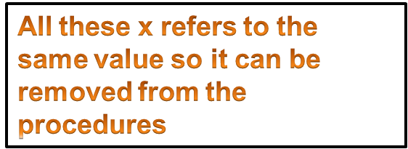
Procedure Localization
(define (sqrt x)
(define (good-enough? guess x)
(< (abs (- (square guess x)) 0.001))
(define (improve guess x)
(average guess (/ x guess)))
(define (sqrt-iter guess x)
(if (good-enough? guess x)
guess
(sqrt-iter (improve guess x) x)))
(sqrt-iter 1.0 x))

Slide 18
Procedure Localization
- Treat x as a free variable available to all sub-procedures except for sqrt().
- The value of free-variable is automatically adopted from the enclosing procedure
(define (sqrt x)
(define (good-enough? guess)
(< (abs (- (square guess x)) 0.001))
(define (improve guess)
(average guess (/ x guess)))
(define (sqrt-iter guess)
(if (good-enough? guess x)
guess
(sqrt-iter (improve guess x) x)))
(sqrt-iter 1.0))

Slide 19
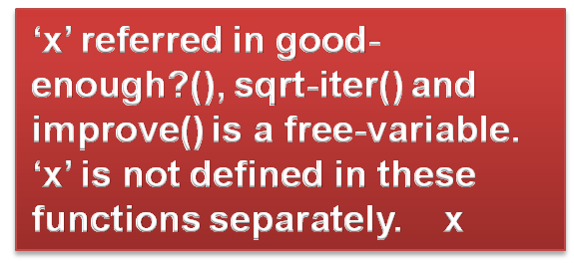
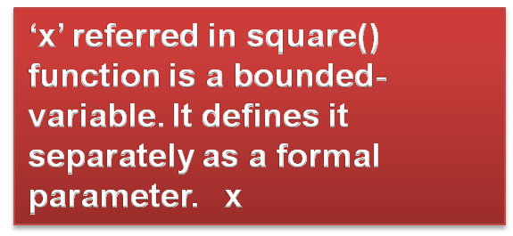
Free-variable vs bounded variable
- Treat x as a free variable available to all sub-procedures except for sqrt().
- The value of free-variable is automatically adopted from the enclosing procedure
(define (sqrt x)
(define (good-enough? guess)
(< (abs (- (square guess x )) 0.001))
(define (improve guess)
(average guess (/ x guess)))
(define (sqrt-iter guess)
(if (good-enough? guess x )
guess
(sqrt-iter (improve guess x ) x )))
  (define (square x ) (* x x ))
(sqrt-iter 1.0))
x

Slide 20

Exercise 1(implement and submit)
Newton's method for cube roots is based on the
fact that if y is an approximation to the cube root
of x, then a better approximation is given by the
Value.
Use this formula to implement a cube-root proc-
edure analogous to the square-root procedure.

Slide 21
Exercise 2
The following procedure computes a mathematical
function called Ackermann's function
(define (A x y)
    (cond ((= y 0) 0)
        ((= x 0) (* 2 y))
        ((= y 1) 2)
        (else (A (- x 1) (A x (- y 1))))))
What are the values of the following expressions?
(A 1 10)
(A 2 4)
(A 3 3)

